Slide 1
Data analysis in Python with Numpy - II
Session 13b

Slide 2
Objectives
Numpy statistical functions
Numpy string functions

Slide 3
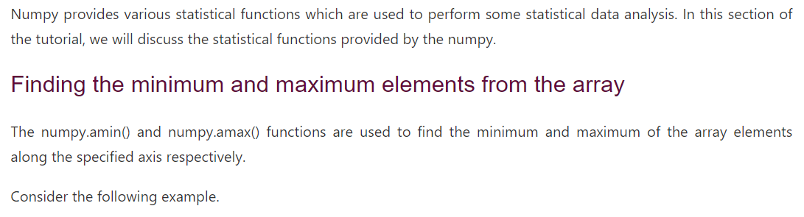
Numpy statistical functions

Slide 4
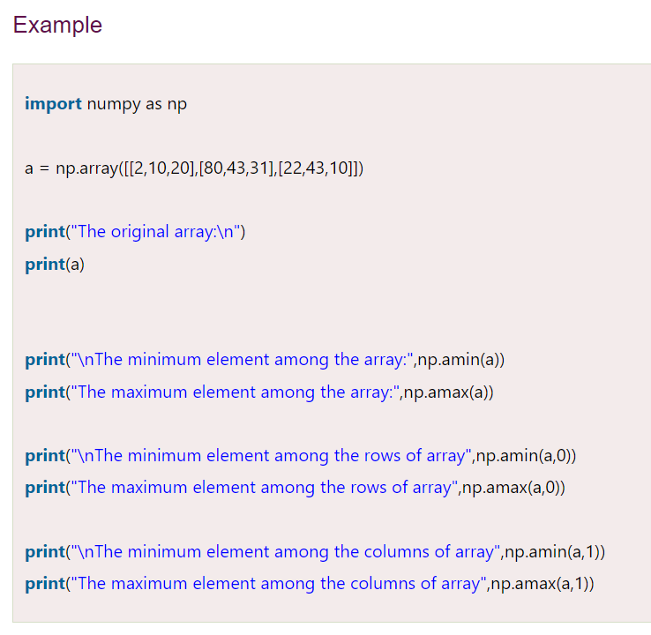
Numpy statistical functions

Slide 5
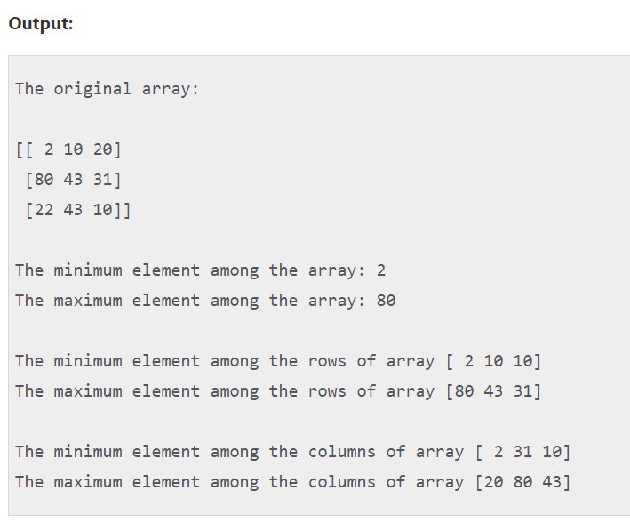
Numpy statistical functions

Slide 6
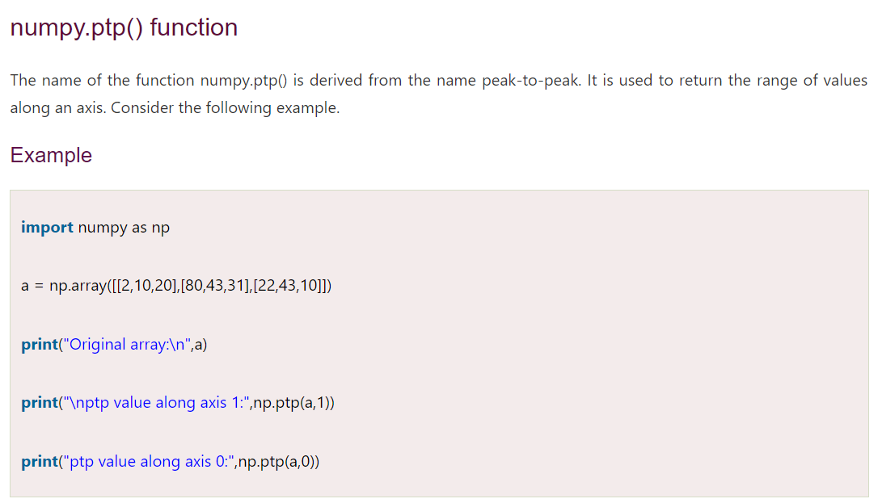
Numpy statistical functions

Slide 7
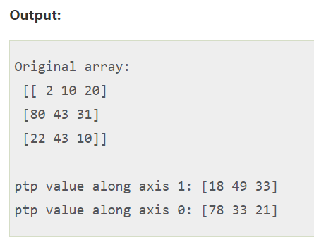
Numpy statistical functions

Slide 8
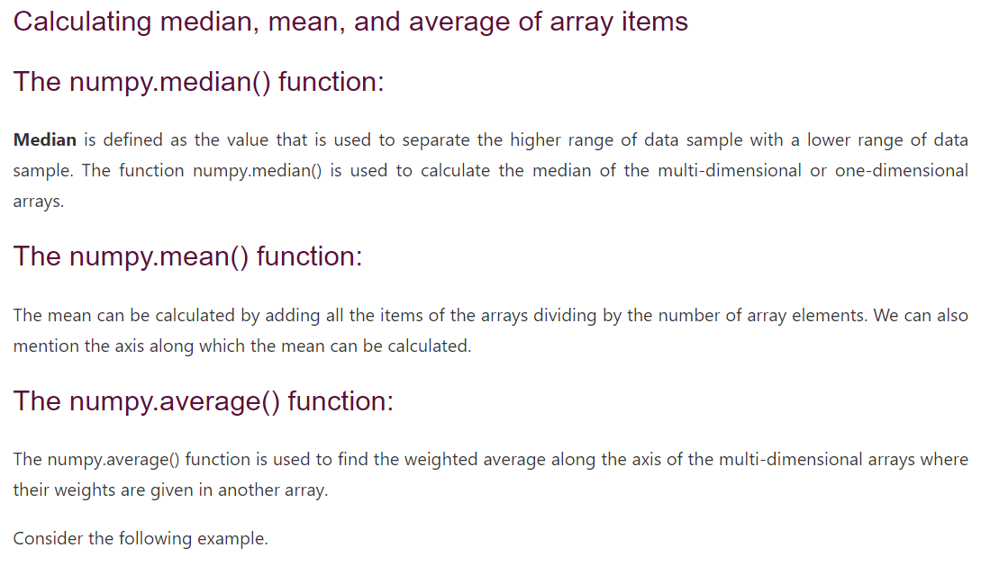
Numpy statistical functions

Slide 9
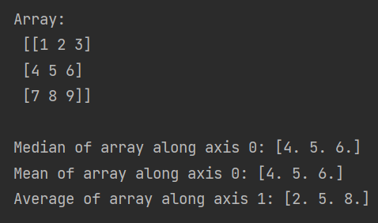
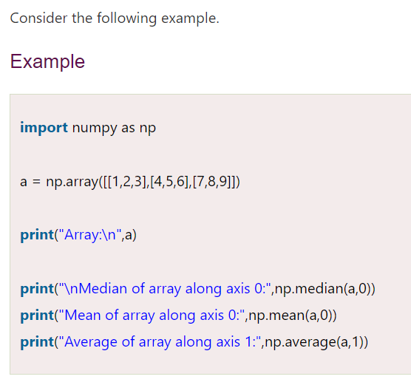
Numpy statistical functions

Slide 10
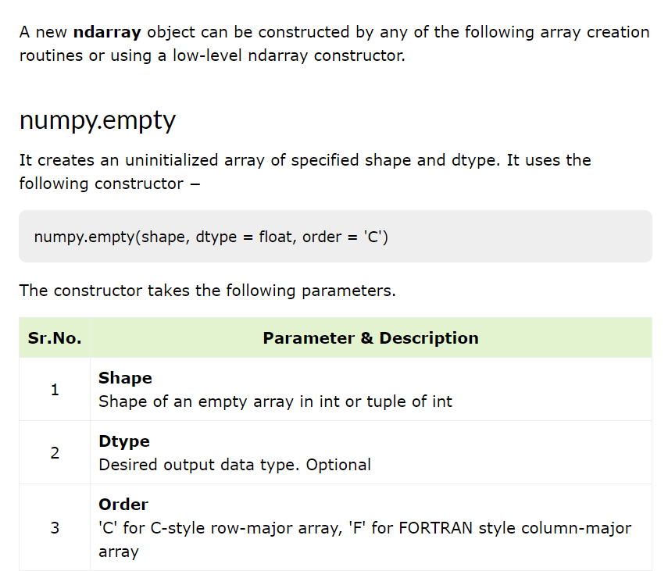
NumPy - Array Creation Routines

Slide 11
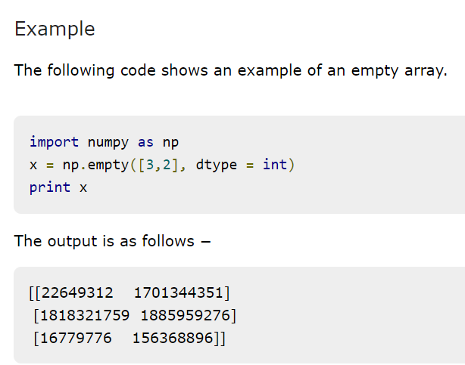

NumPy - Array Creation Routines

Slide 12
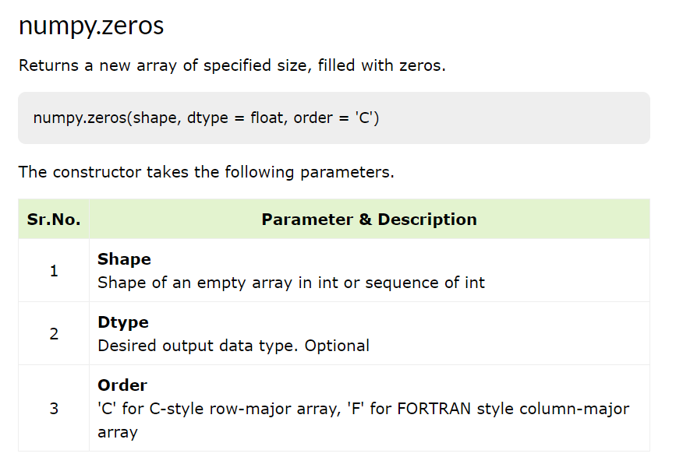
NumPy - Array Creation Routines

Slide 13
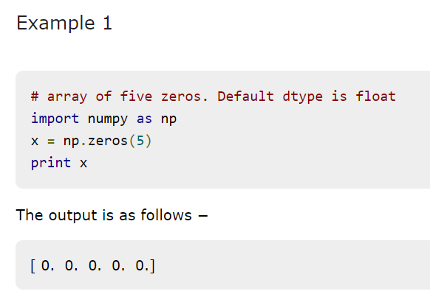
NumPy - Array Creation Routines

Slide 14
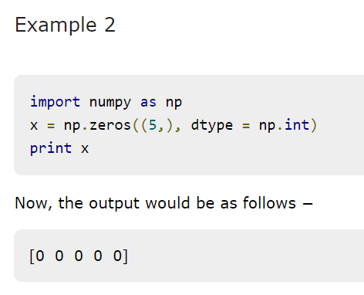
NumPy - Array Creation Routines

Slide 15
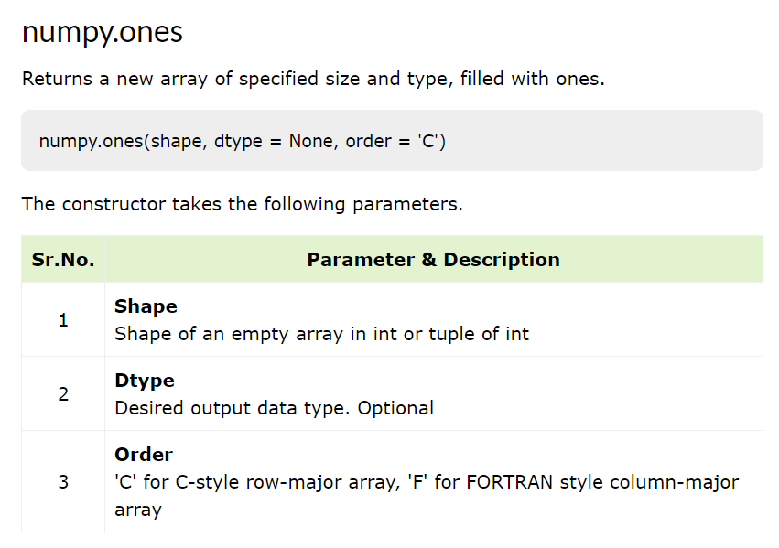
NumPy - Array Creation Routines

Slide 16
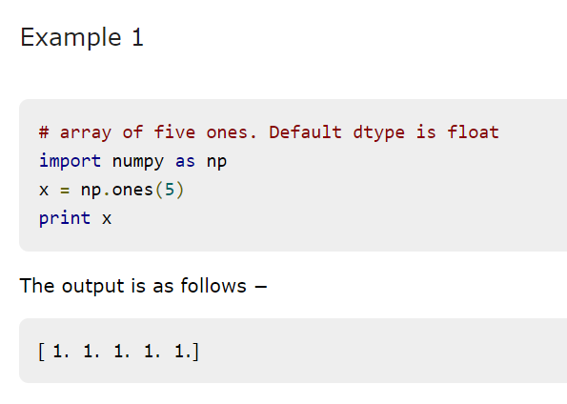
NumPy - Array Creation Routines

Slide 17
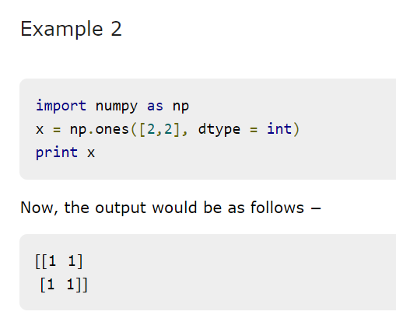
NumPy - Array Creation Routines

Slide 18
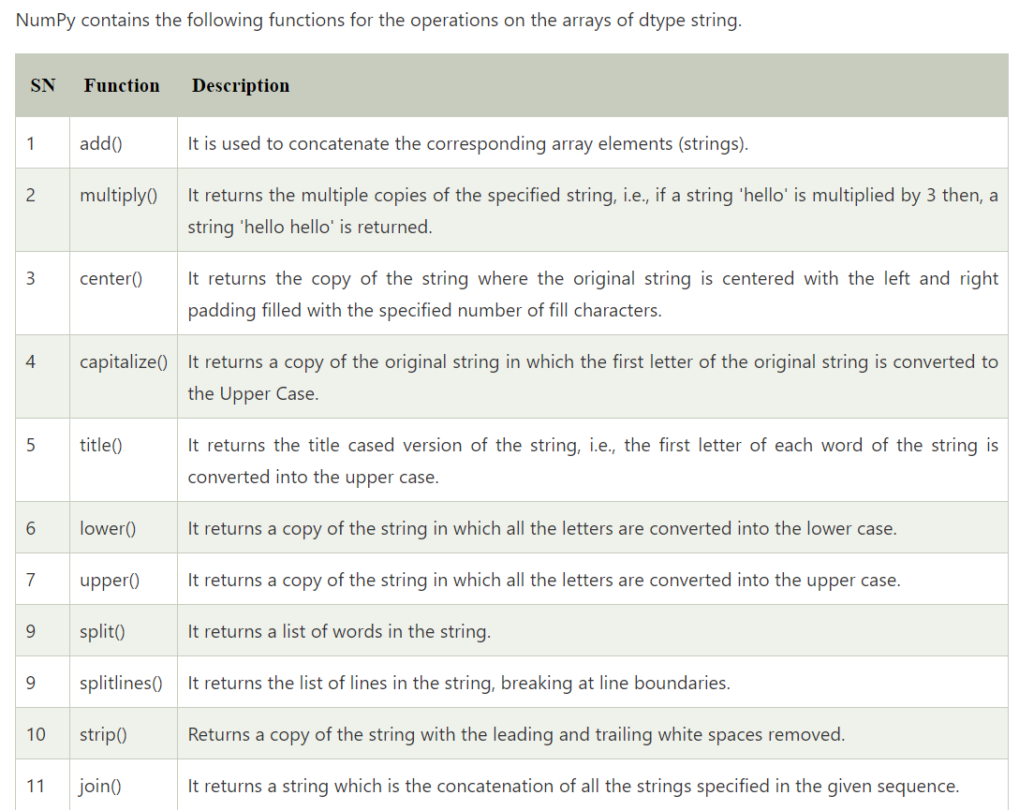
NumPy – String functions

Slide 19
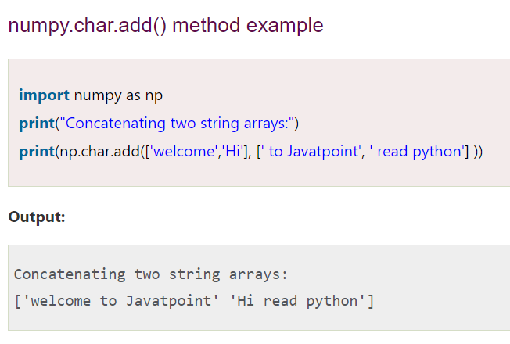
NumPy – String functions

Slide 20
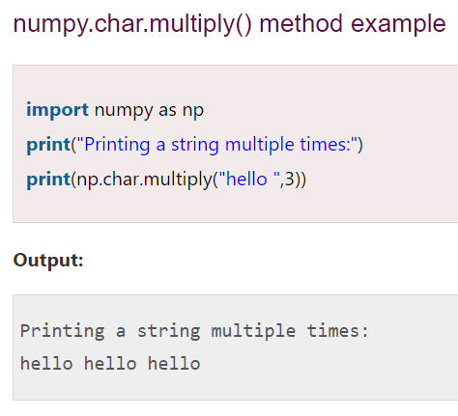
NumPy – String functions

Slide 21
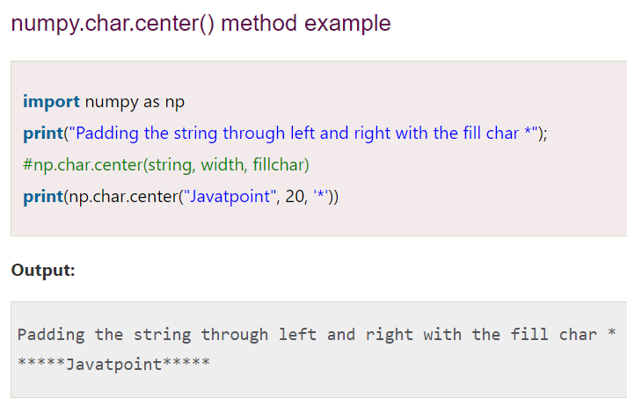
NumPy – String functions

Slide 22
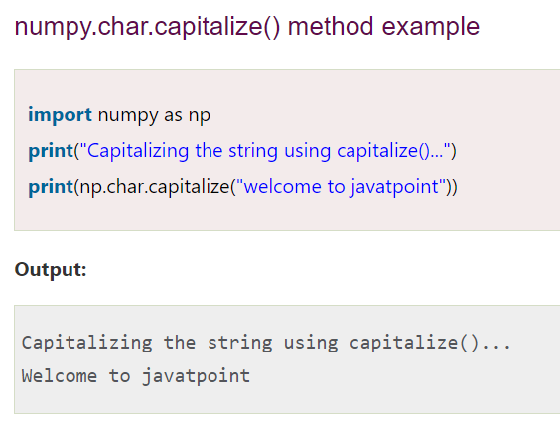
NumPy – String functions

Slide 23
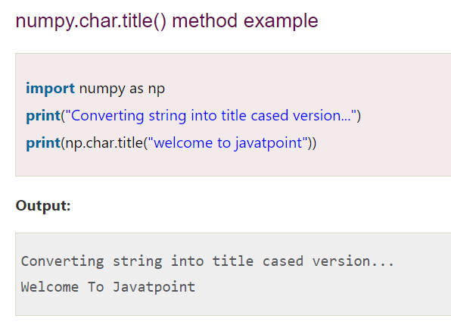
NumPy – String functions

Slide 24
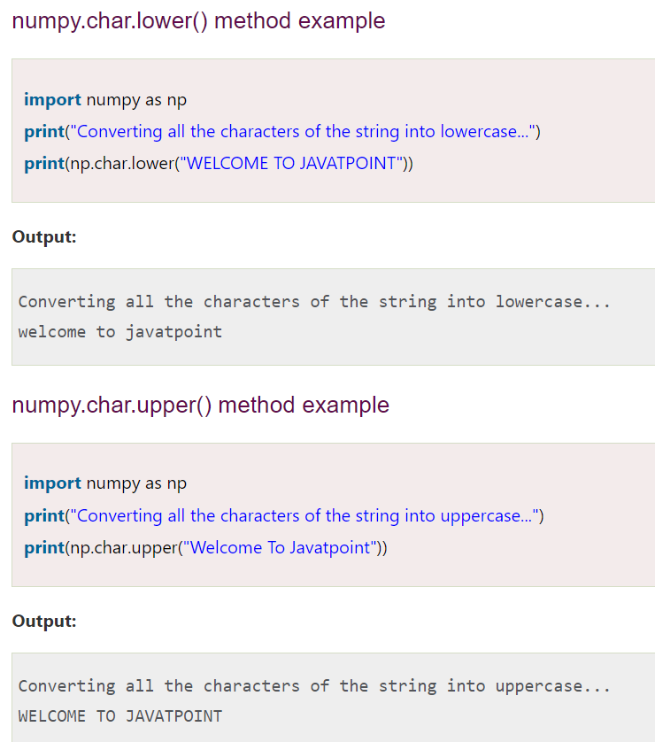
NumPy – String functions

Slide 25
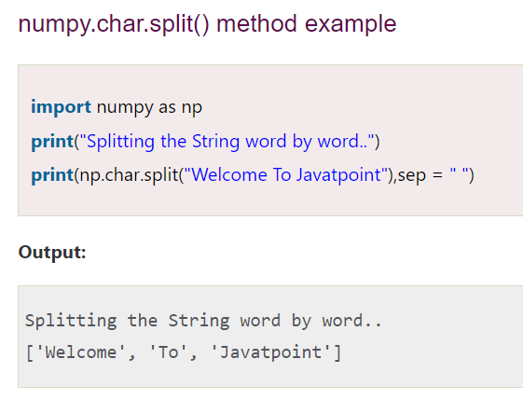
NumPy – String functions

Slide 26
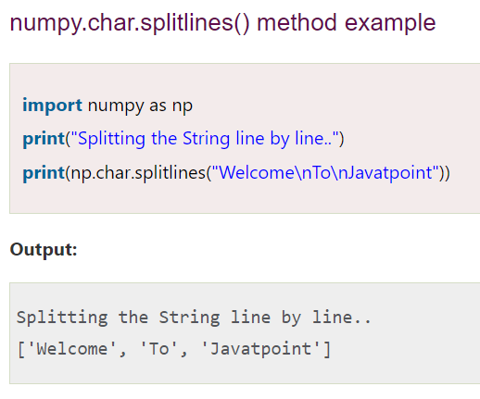
NumPy – String functions

Slide 27
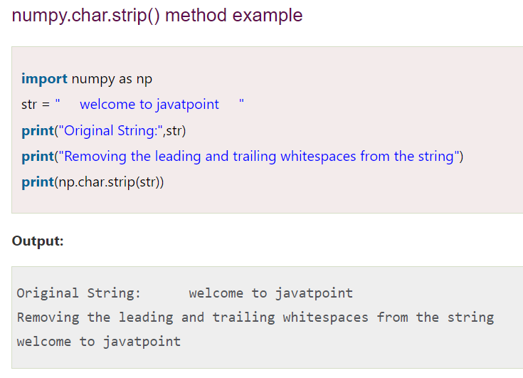
NumPy – String functions

Slide 28
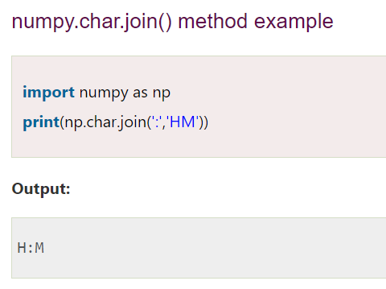
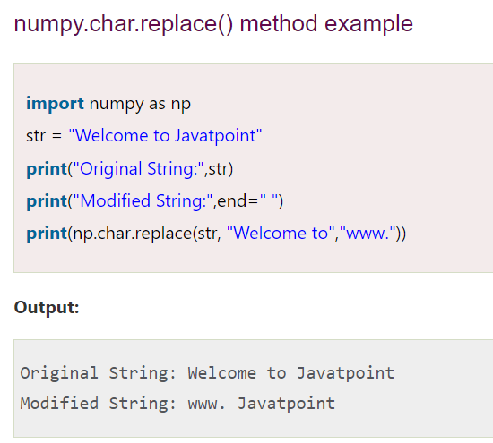
NumPy – String functions

Slide 29
Summary
Numpy statistical functions
Numpy string functions

